Slide 1
NBA Analysis On Injuries
Notes:
Jordan era and grew up a Lakers fan
Orlando and Anfernee 'Penny' Hardaway and Shaquille Oneal

Slide 2
Evolution of the NBA
Noticeable changes in the NBA since the late 90's.
Players are stronger, bigger and faster
Lebron James
In 2005, stricter enforcement of hand-checking rule
Implemented after Kobe and lakers lost to Detroit in the finals
Notes:
With the advancements of sports medicine and basketball analytics and changes in the league the more information the coaching staff has the more longer they can prolongue the players career.
The NBA has changed from the early 90's. Players seem stronger, bigger and faster. Rules like handchecking no longer exist, the 3 pointer has become a key focus to winning a championship(Golden State Warriors). One thing common in the NBA from then and now is injuries.

Slide 3
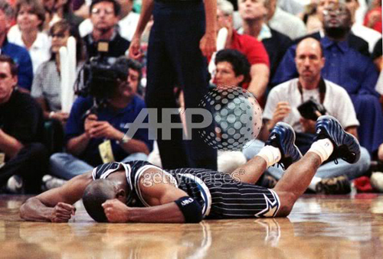
One commonality from then and NOW:
PLAYER INJURY
Anfernee ‘PENNY’ Hardaway
Tall, athletic point gaurd
Anticipated as the next Michael Jordan or Magic Johnson
Suffers a knee Injury in 97-98

Slide 4
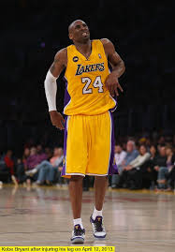
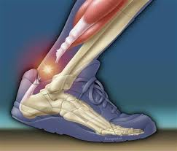
All-star Injuries Cost team Millions
Kobe Bryant
The highest payed player for 7 consecutive years.
2013-14 Sustains Achilles Injury: misses 73 games
Salary: $30,453,805
Cost to LA Lakers:
73 * $370,000/game = $28,000,000
2014-15 Shoulder Injury: Misses 47 games
Salary: $23,500,000
Cost to Lakers:
47 * $287,000/game = $10,000,000
Notes:
NBA rule changes: Harsher punishment for flagrant fouls, Stricter enforcement of the hand-checking rule in 2005
Advancement in sports medicine
Basketball Analytics

Slide 5

Goal
Create an analysis on players stats that contribute to maximizing games played in a season.

Slide 6
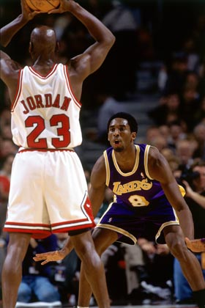


Datasets of 3 different Eras
1996-2002 2004- 2009 2010-2016
*Excluding NBA lockout years 1998-99 and 2011-12

Slide 7
Model: Linear Regression with Lasso
Why Lasso?
Variable Selection: my goal is to eliminate insignificant variables and identify TOP 5 common attributes across all three Eras
Regularization: adding a penalty to solve overfitting
Interpretable

Slide 8
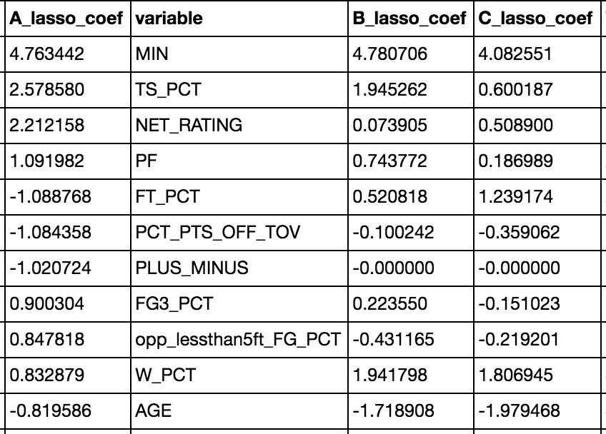
Lasso Beta Coefficients

Slide 9
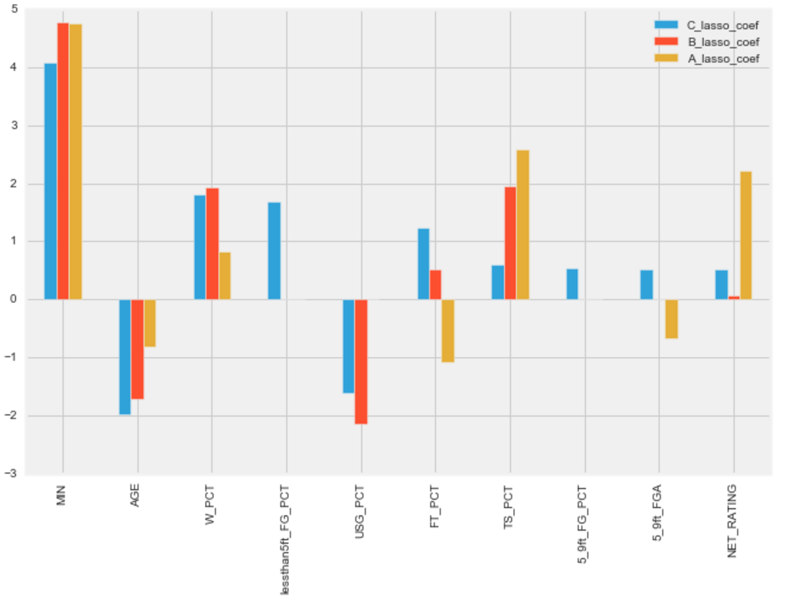
Common Lasso Coefs in all 3 eras:
MIN
W_PCT
NET_RATING
TS_PCT
AGE
Notes:
- Features that fit my assumption
Age: Older you are the less Games played(GP), W_PCT: Win Percentage. To get that W, players willing to play through pain/injury.

Slide 10
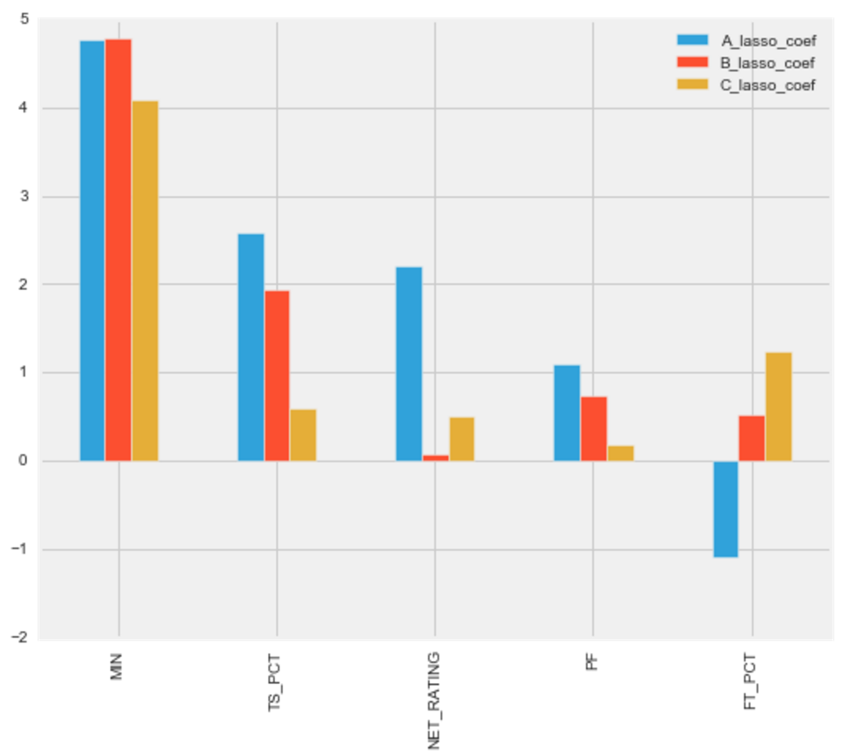
Trend on Avg Minutes per game
MIN decreasing over time
WHY?
Players AVG Minutes are trending down
Notes:
Beta Coefficients from Lasso across 3 eras: A, B, C

Slide 11
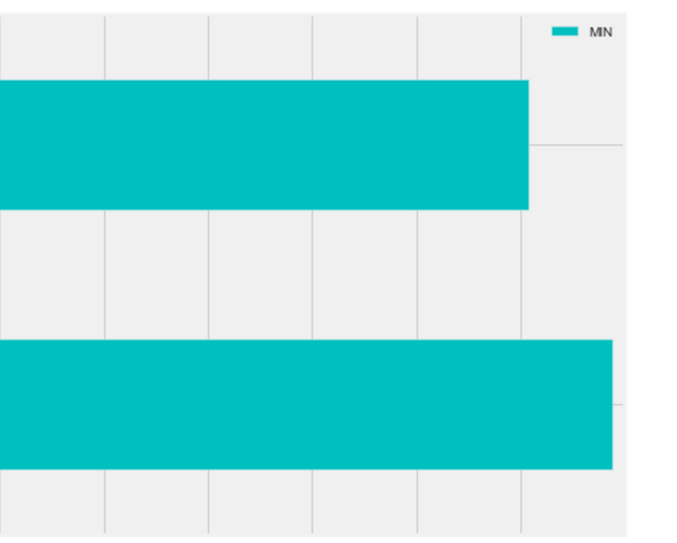
Average MPG: Jordan Era(A) vs Lebron Era(C)
Lebron’s Era(C) playing 4 Minutes less on average than in Jordan’s Era(A)
35.3 MPG
39.3 MPG

Slide 12
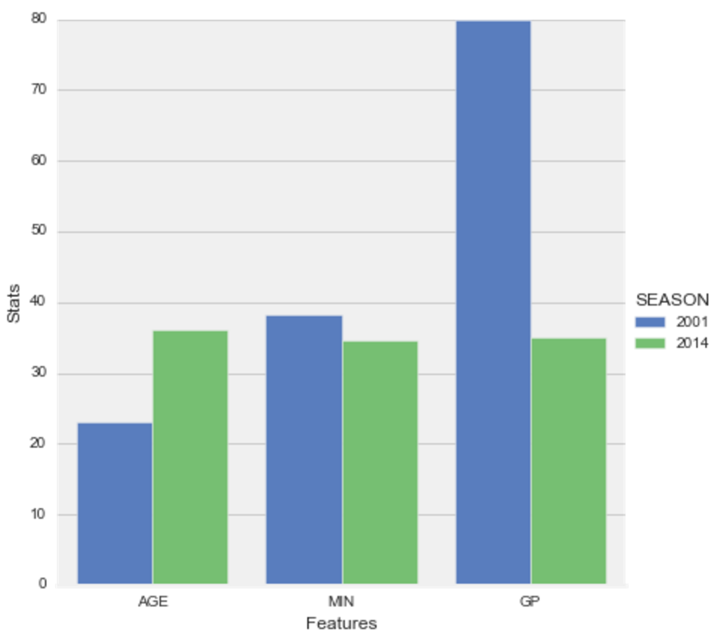
Young vs Old Kobe Bryant
Young Kobe(BLUE)
Age: 23
Average Minutes: 38.3
Games Played: 80
Old Kobe(Green)
Age: 36
Average Minutes: 34.5
Games Played: 35

Slide 13
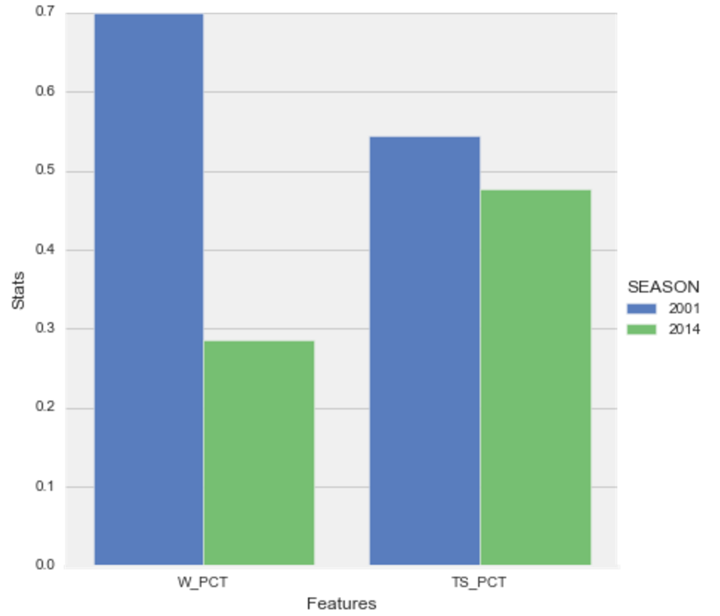
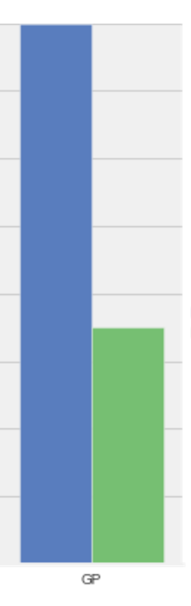
Young vs Old Kobe bryant
Winning Pct, True-Shooting Pct
Young Kobe:
Won more Games
Shot 7 points higher

Slide 14
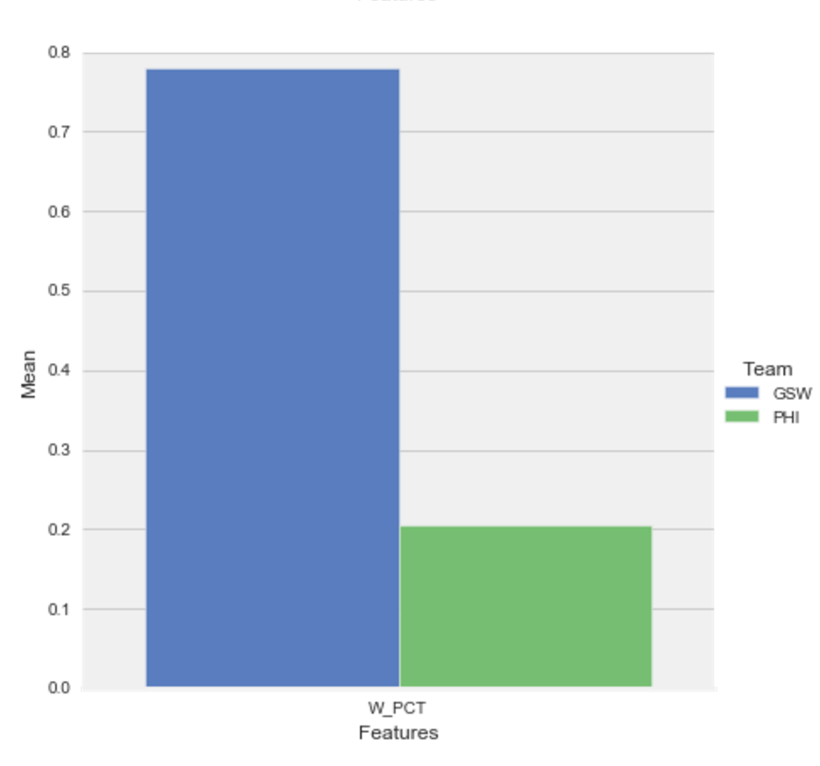
2015 Team Win PCT
Warriors vs Philadelphia 76ers
Philadelphia average W_PCT: 0.20
Warriors average W_PCT: 0.78

Slide 15
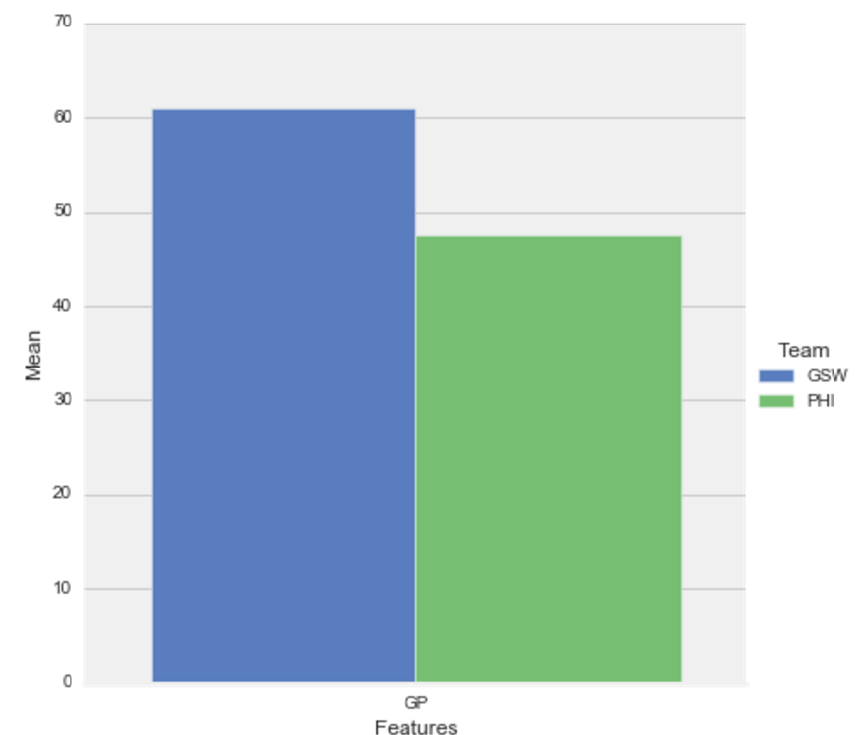
GSW vs 76ers: Games Played in 2015
62 GP
Warrior players average 5 more games played than 76ers players
57 GP
Notes:
Philadelphia: Average GP: 57.1 Warriors: Average GP: 62.8

Slide 16
Lasso Beta coef’s decreasing for TS_PCT and PF
TS_PCT and PF are more significant in Jordan Era than Lebrons in maximizing Games Played.
Notes:
(True Shooting Pct)
(Personal Fouls)

Slide 17
Conclusion:
The top 5 attributes associated with games played are:
MIN, W_PCT, NET_RATING, TS_PCT and AGE
Next steps:
If given more time I'd like to focus more on these top attributes and perform PCA to find hidden variables.
Create a model predicting injuries with Random Forests or Naiive Bayes.

